Slide 1
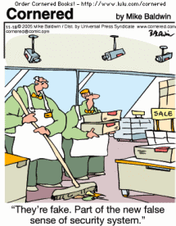
Topics in
Security Testing
[Reading assignment: Chapter 13, pp. 193-209. Note that many more topics are covered in these slides and in class.]

Slide 2

Computer Security
The goal of computer security is to protect computer assets (e.g., servers, applications, web pages, data) from:
  corruption
  unauthorized access
  denial of authorized access
  malicious software
Security is strengthened by:
  physically limiting the access of computers to trusted users
  hardware mechanisms (e.g., biometrics)
  operating system mechanisms that impose rules on untrusted programs (e.g., role-based access control)
  anti-virus software to detect malware
  secure coding techniques (e.g., array bounds checking) to make code less vulnerable to security attacks.

Slide 3


Approach to Software Security
Verify that security mechanisms are trustworthy
Verify that security architecture adheres to the security policy
Verify that the applications that constitute the system are trustworthy
  i.e., they have been developed using secure coding practices, or they are not malware.

Slide 4
Security Architecture
A security architecture is a specification that is used as a guide to enforce security constraints
It specifies where security mechanisms (e.g., encryption, firewalls) need to be positioned in the software architecture
The quality of a security architecture also depends on the security of the applications that constitute the system

Slide 5
Security Architecture
Security architecture describes the position of security mechanisms in the software architecture and comprises:
  subsystems
    e.g., web servers, application servers, DBMS, directories, web applications, and legacy applications
  communication links between the subsystems
    e.g., local or remote function calls and protocols (SSL, HTTPS, LDAP)
  position of security mechanisms
    e.g., authentication and authorization points, encryption methods, audit, logging, monitoring, intrusion detection, registration, backup, recovery

Slide 6
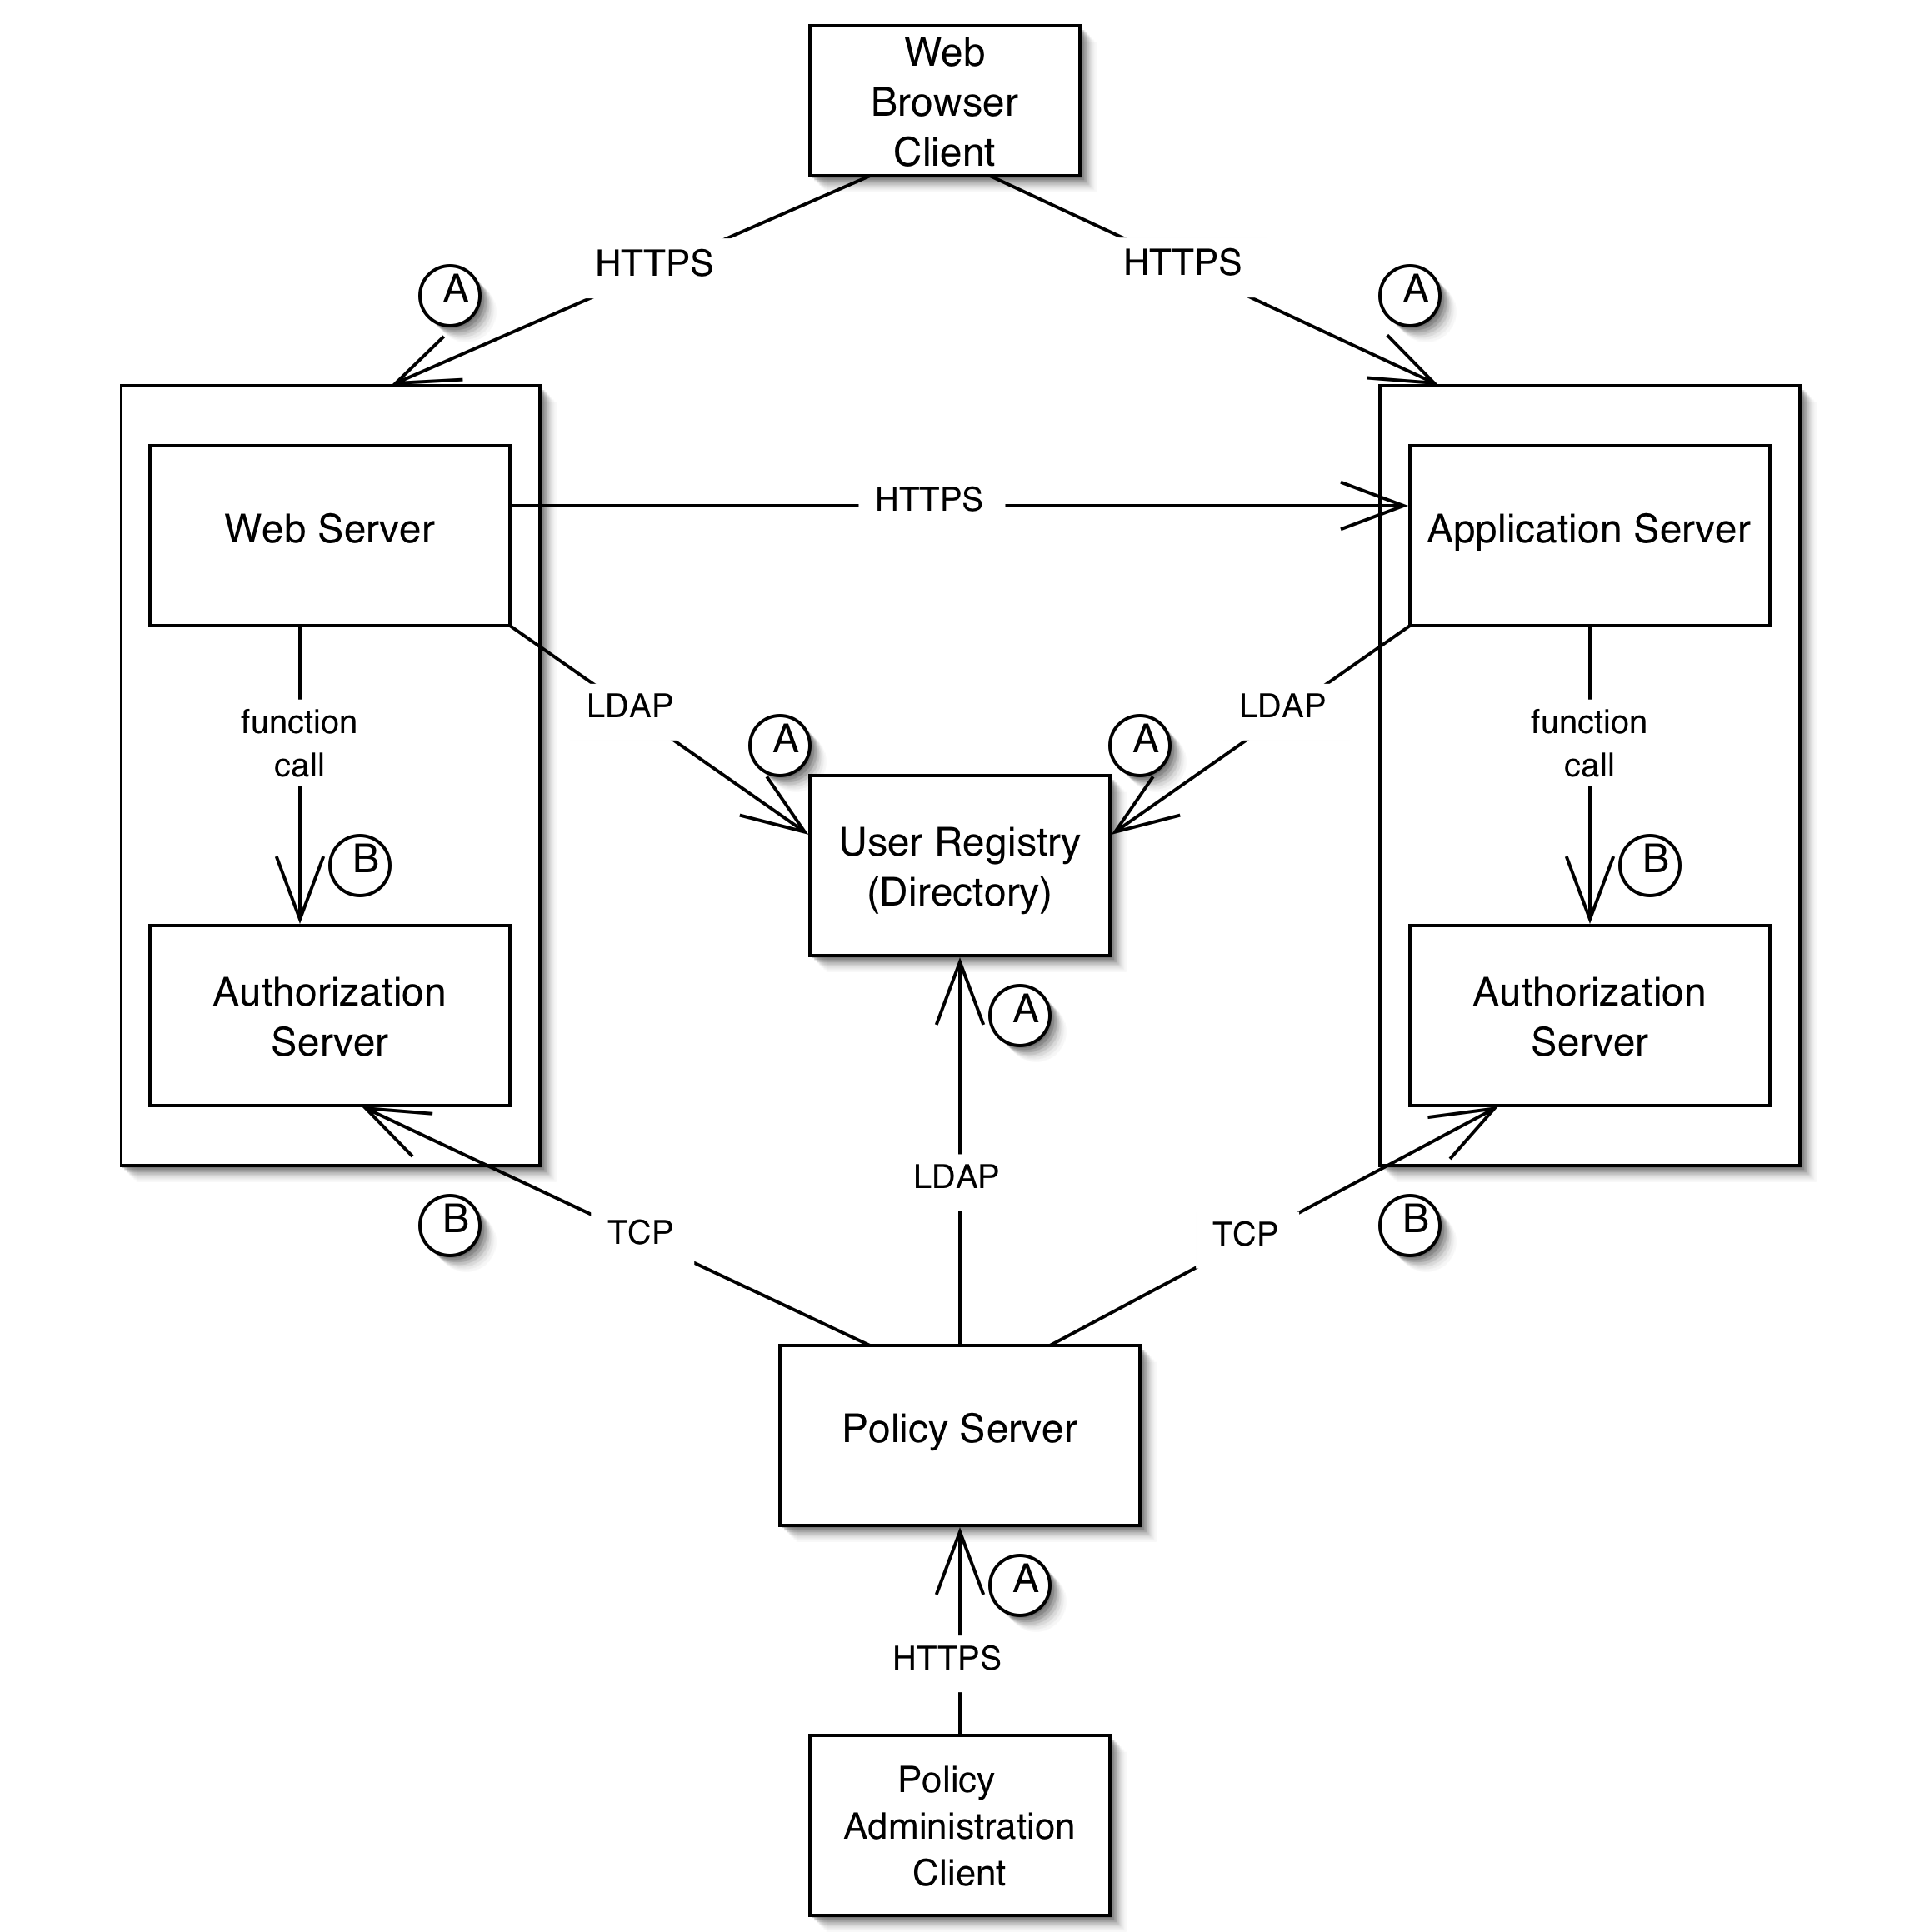
Example of a Security Architecture

Slide 7
Validating Security Architecture
There are many security faults that arise from a poorly designed security architecture, e.g.,
  unauthorized access to data and applications
  confidential and restricted data flowing as unencrypted text over network connections
Security architecture is validated using a process called threat modeling.
Threat modeling is typically a manual (i.e., not automated) inspection process, similar to code and requirements inspection.

Slide 8
Threat modeling
Threat Modeling is a process for evaluating a software system for security issues.
It is a variation of the code and specification inspections processes discussed earlier in the course.
The goal is for a review team to look for software features that vulnerable from a security perspective.
Threat modeling is not the responsibility of a software tester, although testers may be involved in the security review team.

Slide 9
Threat modeling process (1)
Assemble the treat modeling team
  Include security experts and consultants
Identify the assets
  E.g., credit card numbers, social security numbers, computing resources, trade secrets, financial data
Create an architecture overview
  Define the architecture and identify the trust boundaries and authentication mechanisms
Decompose the application
  E.g., identify data flows, encryption processes, password flows.

Slide 10
Threat modeling process (2)
Identify threats
  E.g., can data be viewed, changed? Limit access of legitimate users? Unauthorized access of the system?
Document threats
  E.g., describe threat, target, form of attack, counter-measures to prevent an attack, etc.
Rank threats (scale: low, medium, high)
  Damage potential
    E.g., property, data integrity, financial loss
  Reproducibility
    E.g., probability that an attempt to compromise the system will succeed
  Exploitability/Discoverability
    E.g., is it difficult to hack into the system?
  Affected users
    How many users will be affected? Who are these users? Are they important?

Slide 11
What is Malware?
Malware (malicious software) is any program that works against the interest of the system’s user or owner.
Question: Is a program that spies on the web browsing habits of the employees of a company considered malware?
What if the CEO authorized the installation of the spying program?

Slide 12
Uses of Malware
Why do people develop and deploy malware?
  Financial gain
  Psychological urges and childish desires to “beat the system”.
  Access private data
  …

Slide 13
Typical purposes of Malware
Backdoor access:
  Attacker gains unlimited access to the machine.
Denial-of-service (DoS) attacks:
  Infect a huge number of machines to try simultaneously to connect to a target server in hope of overwhelming it and making it crash.
Vandalism:
  E.g., defacing a web site.
Resource Theft:
  E.g., stealing other user’s computing and network resources, such as using your neighbors’ Wireless Network.
Information Theft:
  E.g., stealing other user’s credit card numbers.

Slide 14
Types of Malware
Viruses
Worms
Trojan Horses
Backdoors
Mobile code
Adware
Sticky software

Slide 15


Antivirus programs
Antivirus programs identify malware by looking for unique signatures in the code of each program (i.e., potential virus) on a computer
  A signature is a unique sequence of code found in a part of the malicious program
The antivirus program maintains a frequently updated database of virus signatures
  The goal is for the database to contain a signature for every known malware program
Examples of antivirus software:
  Symantec (http://www.symantec.com)
  McAfee (http://www.mcafee.com)

Slide 16
Viruses
Viruses are self-replicating programs that usually have a malicious intent.
Old fashioned type of malware that has become less popular since the widespread use of the Internet.
The unique aspect of computer viruses is their ability to self-replicate.
However, someone (e.g., user) must execute them in order for them to propagate.

Slide 17
Viruses (Cont’d)
Some viruses are harmful (e.g.,):
  delete valuable information from a computer’s disk,
  freeze the computer.
Other viruses are harmless (e.g.,):
  display annoying messages to attract user attention,
  just replicate themselves.

Slide 18
Viruses: Operation
Viruses typically attach themselves to executable program files
  e.g., .exe files in MS Windows
Then the virus slowly duplicates itself into many executable files on the infected system.
Viruses require human intervention to replicate.

Slide 19
Origin of the term computer virus
The term computer virus was first used in an academic publication by Fred Cohen in his 1984 paper Experiments with Computer Viruses.
However, a mid-1970s science fiction novel by David Gerrold, When H.A.R.L.I.E. was One, includes a description of a fictional computer program called VIRUS.
John Brunner's 1975 novel The Shockwave Rider describes programs known as tapeworms which spread through a network for deleting data.
The term computer virus also appears in the comic book Uncanny X-Men in 1982.

Slide 20
The first computer viruses
A program called Elk Cloner is credited with being the first computer virus to appear "in the wild". Written in 1982 by Rich Skrenta, it attached itself to the Apple DOS 3.3 operating system and spread by floppy disk.
The first PC virus was a boot sector virus called (c)Brain, created in 1986 by two brothers, Basit and Amjad Farooq Alvi, operating out of Lahore, Pakistan.

Slide 21
Worms
Worms are malicious programs that use the Internet to spread.
Similar to a virus, a worm self-replicates.
Unlike a virus, a worm does not need human intervention to replicate.
Worms have the ability to spread uncontrollably in a very brief period of time.
  Almost every computer system in the world is attached to the same network.

Slide 22
Worms: Operation
A worm may spread because of a software vulnerability exploit:
  Takes advantage of the OS or an application program with program vulnerabilities that allow it to hide in a seemingly innocent data packet.
A worm may also spread via e-mail.
  Mass mailing worms scan the user’s contact list and mail themselves to every contact on such a list.
  In most cases the user must open an attachment to trigger the spreading of the worm (more like a virus).

Slide 23
Trojan horses
A Trojan Horse is a seemingly innocent application that contains malicious code that is hidden somewhere inside it.
Trojans are often useful programs that have unnoticeable, yet harmful, side effects.

Slide 24
Trojan horses: Operation (1)
Embed a malicious element inside an otherwise benign program.
The victim:
  receives the infected program,
  launches it,
  remains oblivious of the fact that the system has been infected.
The application continues to operate normally to eliminate any suspicion.

Slide 25
Trojan horses: Operation (2)
Fool users into believing that a file containing a malicious program is really an innocent file such as a video clip or an image.
This is easy to do on MS Windows because file types are determined by their extension as opposed to examining the file headers.
E.g.,
  “A Great Picture.jpg .exe”
  The .exe might not be visible in the browser.
  The Trojan author can create a picture icon that is the default icon of MS Windows for .jpg files.

Slide 26
Backdoors
A backdoor is malware that creates a covert access channel that the attacker can use for:
  connecting,
  controlling,
  spying,
  or otherwise interacting with the victim’s system.

Slide 27
Backdoors: Operation
Backdoors can be embedded in actual programs that, when executed, enable the attacker to connect to and to use the system remotely.
Backdoors may be planted into the source code by rogue software developers before the product is released.
  This is more difficult to get away with if the program is open source.

Slide 28
Mobile code
Mobile code is a class of benign programs that are:
  meant to be mobile,
  meant to be executed on a large number of systems,
  not meant to be installed explicitly by end users.
Most mobile code is designed to create a more active web browsing experience.
  E.g., Java applets, ActiveX controls.

Slide 29
Mobile code (Cont’d)
Java scripts are distributed in source code form making them easy to analyze.
ActiveX components are conventional executables that contain native IA-32 machine code.
Java applets are in bytecode form, which makes them easy to decompile.

Slide 30
Mobile code: Operation
Web sites quickly download and launch a program on the end user’s system.
User might see a message that warns about a program that is about to be installed and launched.
  Most users click OK to allow the program to run.
  They may not consider the possibility that malicious code is about to be downloaded and executed on their system.

Slide 31
Adware
Adware is a program that forces unsolicited advertising on end users.
Adware is a new category of malicious programs that has become very popular.
Adware is usually bundled with free software that is funded by the advertisements displayed by the Adware program.

Slide 32
Adware: Operation (1)
The program gathers statistics about the end user’s browsing and shopping habits.
  The data might be transferred to a remote server.
Then the Adware uses the information to display targeted advertisements to the end user.

Slide 33
Adware: Operation (2)
Adware can be buggy and can limit the performance of the infected machine.
  E.g., MS IE can freeze for a long time because an Adware DLL is poorly implemented and does not use multithreading properly.
Ironically, buggy Adware defeats the purpose of the Adware itself.

Slide 34
Sticky software
Sticky software implements methods that prevent or deter users from uninstalling it manually.
One simple solution is not to offer an uninstall program.
Another solution in Windows involves:
  installing registry keys that instruct Windows to always launch the malware as soon as the system is booted.
  The malware monitors changes to the registry and replace the keys of they are deleted by the user.
  The malware uses two mutually monitoring processes to ensure that the user does not terminate the malware before deleting the keys.

Slide 35
Future Malware
Today’s malware is just the tip of the iceberg.
The next generation of malware may take control of the low levels of the computer system (e.g., BIOS, Firmware).
  The antidote software will be in the control of the malware …
Also the theft of valuable information can result in holding it for ransom.

Slide 36
Information-stealing worms
Present-day malware does not take advantage of cryptography much.
Asymmetric encryption creates new possibilities for the creation of information-stealing worms.
A worm encrypts valuable data on the infected system using an asymmetric cipher and hold the data as ransom.

Slide 37
Information-stealing worms:Operation
The Kleptographic worm embeds a public encryption key in its body.
It starts encrypting every bit of valuable data on the host using the public key.
Decryption of the data is impossible without the private key.
Attacker blackmails the victim demanding ransom.
Attacker exchanges the private key for the ransom while maintaining anonymity.
  Theoretically possible using zero-knowledge proofs
  Attacker proves that he has the private key without exposing it.

Slide 38
BIOS/Firmware Malware
Antivirus programs assume that there is always some trusted layer of the system.
Naïve antivirus programs scan the hard drive for infected files using the high-level file-system service.
A clever virus can intercept file system calls and present to the virus with fake versions (original/uninfected) of the files on disk.
Sophisticated antivirus programs reside at a low enough level (in OS kernel) so that malware cannot distort their view of the system.

Slide 39
BIOS/Firmware Malware: Operations (1)
What is the malware altered an extremely low level layer of the system?
Most CPUs/hardware devices run very low-level code that implements each assembly language instruction using low level instructions (micro-ops).
The micro-ops code that runs inside the processor is called firmware.
Firmware can be updated using a firmware-updating program.

Slide 40
BIOS/Firmware Malware: Operations (2)
Malicious firmware can (in theory) be included in malware that defeats antivirus programs.
The hardware will be compromised by the malicious firmware.
Not easy to do in practice because firmware update files are encrypted (private key inside the processor).

Slide 41
Antivirus programs
Antivirus programs identify malware by looking for unique signatures in the code of each program (i.e., potential virus) on a computer.
  A signature is a unique sequence of code found in a part of the malicious program.
The antivirus program maintains a frequently updated database of virus signatures.
  The goal is for the database to contain a signature for every known malware program.
Well known antivirus software includes:
  Symantec (http://www.symantec.com)
  McAfee (http://www.mcafee.com)

Slide 42
Polymorphic viruses
Polymorphism is a technique that thwarts signature-based identification programs.
Polymorphic viruses randomly encode or encrypt the program code in a semantics-preserving way.
The idea is to encrypt the code with a random key and decrypt it at runtime.
  Each copy of the code is different because of the use of a random key.

Slide 43
Polymorphic viruses:
Decryption technique
A decryption technique that polymorphic viruses employ involves “XORing” each byte with a randomized key that was saved by the parent virus.
The use of XOR-operations has the additional advantage that the encryption and decryption routine are the same:
  a xor b = c
  c xor b = a

Slide 44
Polymorphic viruses: Weaknesses
Many antivirus programs scan for virus signatures in memory.
  I.e., after the polymorphic virus has been decrypted.
If the virus code that does the decryption is static, then the decryption code can be used as a signature.
This limitation can be addressed (somewhat) if the decryption code is scrambled (superficially):
  randomize the use of registers,
  add no-ops in the code, …

Slide 45
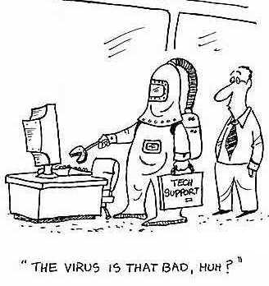
Metamorphic viruses
Instead of encrypting the program’s body and making slight alterations in the decryption engine, alter the entire program each time it is replicated.
This makes it extremely difficult for antivirus writers to use signature-matching techniques to identify malware.
Metamorphism requires a powerful code analysis engine that needs to be embedded into the malware.

Slide 46
Metamorphic viruses: Operation
Metamorphic engine scans the code and generates a different version of it every time the program is duplicated.
The metamorphic engine performs a wide variety of transformations on the malware and on the engine itself.
  Instruction and register randomization.
  Instruction ordering
  Reversing (negating) conditions
  Insertion of “garbage” instructions
  Reordering of the storage location of functions

Slide 47
Timeline of famous malware (1982-1988) [wikipedia]
1982
  Elk Cloner, written for Apple II systems, is credited with being the first computer virus.
1987
  (c)Brain, the first virus written for PCs.
  SCA, a boot sector virus for Amiga appears, immediately creating a pandemic virus-writer storm. A short time later, SCA releases another, considerably more destructive virus, the Byte Bandit.
1988
  Morris worm infects DEC VAX machines connected to the Internet, and becomes the first worm to spread extensively.

Slide 48
Timeline of famous malware (1998-2000) [wikipedia]
1998
  CIH virus version 1.
1999
  Melissa worm is released, targeting Microsoft Word and Outlook-based systems, and creating considerable network traffic.
2000
  The VBS/Loveletter worm, also known as the "I love you" virus appeared. As of 2004, this was the most costly virus to business, causing upwards of 10 billion dollars in damage.

Slide 49
Timeline of famous malware (2001) [wikipedia]
Klez worm.
Nimda worm.
Code Red II worm (spreads in China, attacks Microsoft's Internet Information Services.
Sircam worm (spreads through e-mails and unprotected network shares).
Sadmind worm (spreads by exploiting holes in both Sun Microsystem's Solaris and MS IIS).
Raman worm (similar to the Morris worm infected only Red Hat Linux machines running version 6.2 and 7.0, using three vulnerabilities in wu-ftpd,rpc-statd and lpd.

Slide 50
Timeline of famous malware (2003) [wikipedia]
Sober worm is first seen and maintains its presence until 2005 with many new variants.
Sobig worm (technically the Sobig.F worm) spread rapidly via mail and network shares.
Blaster worm also know as the Lovesan worm spread rapidly by exploiting MS computers.
SQL slammer worm also known as the Sapphire worm, attacked vulnerabilities in Microsoft SQL Server and MSDE, causes widespread problems on the Internet.

Slide 51
Timeline of famous malware (2004) [wikipedia]
Sasser worm emerges by exploiting a vulnerability in LSASS, causes problems in networks.
Witty worm is a record breaking worm in many regards.
  It exploited holes in several Internet Security Systems (ISS) products.
  it was the first internet worm to carry a destructive payload and it spread rapidly using a pre-populated list of ground-zero hosts.
MyDoom emerges, and currently holds the record for the fastest-spreading mass mailer worm.

Slide 52
Timeline of famous malware (2005) [wikipedia]
Zotob worm, the effect was overblown because several United States media outlets were infected.

Slide 53
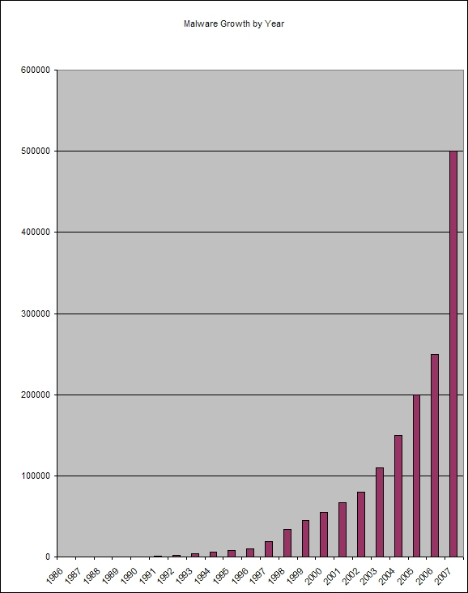
Malware Growth by Year

Slide 54
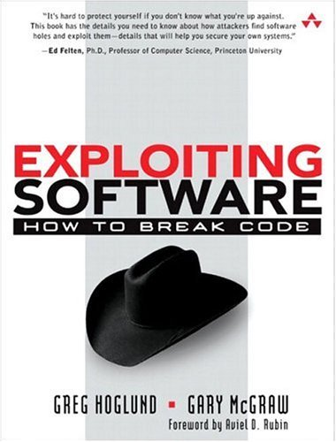
Secure Coding
Secure coding involves programming practices and run-time mechanisms that can limit the vulnerability of applications to to malware.
Common malware exploits arise from coding problems:
  buffer overflows
  format string vulnerabilities
  integer vulnerabilities
Buffer overflow attacks cost the software industry hundreds of millions of dollars per year.
  C/C++ code is the overwhelming target of buffer overflow, format string, and integer vulnerability attacks.

Slide 55
Software vulnerability
What are software vulnerabilities?
Types of vulnerabilities
  E.g., Buffer Overflows
How to find these vulnerabilities and prevent them?
Classes of software vulnerabilities
A software vulnerability is an instance of a fault in the specification, development, or configuration of software such that its execution can violate the (implicit or explicit) security policy.

Slide 56
Types of software vulnerability
Buffer overflows
  Smash the stack
  Overflows in setuid regions
Heap overflows
Format string vulnerabilities

Slide 57
What is a buffer?
Example:
  A place on a form to fill in last name where each character has one box.
“Buffer” is used loosely to refer to any area of memory where more than on piece of data is stored.

Slide 58
Buffer overflows
The most common form of security vulnerability in the last 10 years
  1998: 2 out of 5 “remote to local” attacks in Lincoln Labs Intrusion Detection Evaluation were buffer overflows.
  1998: 9 out of 13 CERT advisories involved buffer overflows.
  1999: at least 50% of CERT advisories involved buffer overflows.

Slide 59
How does a buffer overflow happen?
Reading or writing past the end of the buffer → overflow
As a result, any data that is allocated near the buffer can be read and potentially modified (overwritten)
  A password flag can be modified to log in as someone else.
  A return address can be overwritten so that it jumps to arbitrary code that the attacker injected (smash the stack) → attacker can control the host.

Slide 60
Two steps
Arrange for suitable code to be available in the program’s address space (buffer)
  Inject the code
  Use code that is already in the program
Overflow the buffer so that the program jumps to that code.

Slide 61
Inject the code
Use a string as input to the program which is then stored in a buffer.
String contains bytes that are native CPU instructions for attacked platform.
Buffer can be located on the stack, heap, or in static data area.

Slide 62
Code already in program
Only need to parameterize the code and cause the program to jump to it.
Example:
  Code in libc that executes “exec(arg)”, where arg is a string pointer argument, can be used to point to “/bin/sh” and jump to appropriate instructions in libc library.

Slide 63
Jump to attack code
Activation record
  stack smashing attack
Function pointer
Longjpm(3) buffer

Slide 64
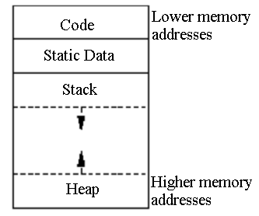
Memory regions

Slide 65
Code/text segment
Static
Contains code (instructions) and read-only data
Corresponds to text section of executable file
If attempt to write to this region → segmentation violation

Slide 66
Data segment
Permanent data with statically known size
Both initiated and uninitiated variables
Corresponds to the data-bss sections of the executable file
brk(2) system call can change data segment size
Not enough available memory → process is blocked and rescheduled with larger memory

Slide 67
Heap
Dynamic memory allocation
malloc() in C and new in C++ → More flexibility
More stable data storage – memory allocated in the heap remains in existence for the duration of a program
Data with unknown lifetime – global (storage class external) and static variables

Slide 68
Stack – I
Provides high-level abstraction
  Allocates local variables when a function gets called (with known lifetime)
  Passes parameters to functions
  Returns values from functions
Push/Pop operations (LIFO) – implemented by CPU
Size – dynamically adjusted by kernel at runtime

Slide 69
Stack – II
Stack Pointer (SP) – TOP of stack (or next free available address)
Fixed address – BOTTOM of stack
Logical Stack Frame (SF) – contains parameters to functions, local variables, data to recover previous SF (e.g: instruction pointer at time of function call)
Frame Pointer (FP)/local Base Pointer (BP) – Beginning of Activation Record (AR), used for referencing local variables and parameters (accessed as offsets from BP)

Slide 70
Activation record
Contains all info local to a single invocation of a procedure
  Return address
  Arguments
  Return value
  Local variables
  Temp data
  Other control info

Slide 71
Accessing an activation record
Base pointer: beginning of AR
  Arguments are accessed as offsets from bp
Environment pointer: pointer to the most recent AR (usually a fixed offset from bp)
Stack pointer: top of AR stack
  Temporaries are allocated on top on stack

Slide 72
When a procedure is called
Previous FP is saved
SP is copied into FP → new FP
SP advances to reserve space for local variables
Upon procedure exit, the stack is cleaned up

Slide 73
Function pointer
Find a buffer adjacent to function pointer in stack, heap or static data area
Overflow buffer to change the function pointer so it jumps to desired location
Example: attack against superprobe program - Linux

Slide 74
Longjpm buffer
setjmp(buffer) to set a checkpoint
longjmp(buffer) to go back to checkpoint
Corrupt state of buffer so that longjmp(buffer) jumps to the attack code instead

Slide 75
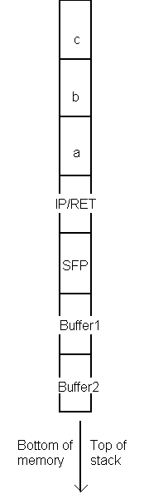
Example
pushl $3
pushl $2
pushl $1
call function
pushl %ebp
movl %esp,%ebp
subl $20,%esp
void function(int a, int b, int c) {
char buffer1[5];
char buffer2[10];
}
void main() {
function(1,2,3);
}

Slide 76
Buffer overflow example
void main() {
int x;
x = 0;
function(1,2,3);
x = 1;
printf("%d\n",x);
}
void function(int a, int b, int c) {
char buffer1[5];
char buffer2[10];
int *ret;
ret = buffer1 + 12;
(*ret) += 8; }

Slide 77
Result of program
Output: 0
Return address has been modified and the flow of execution has been changed
All we need to do is place the code that we are trying to execute in the buffer we are overflowing, and modify the return address so it points back to buffer

Slide 78
Example [6]
char shellcode[ ] = “\xeb\x1f\x5e\x89\x76\x08\x31\xc0\x88\x46\x07\x89\x46\x0c\xb0\x0b” “\x89\xf3\x8d\x4e\x08\x8d\x56\x0c\xcd\x80\x31\xdb\x89\xd8\x40\xcd”
“x80\xe8\xdc\xff\xff\xff/bin/sh”;
char large_string[128];
void main() {
char buffer[96];
int i;
long *long_ptr = (long *) large_string; /* long_ptr takes the address of large_string */
/* large_string’s first 32 bytes are filled with the address of buffer */
for (i = 0; i < 32; i++)
*(long_ptr + i) = (int) buffer;
/* copy the contents of shellcode into large_string */
for (i = 0; i < strlen(shellcode); i++)
large_string[ i ] = shellcode[ i ];
/* buffer gets the shellcode and 32 pointers back to itself */
strcpy(buffer, large_string); }

Slide 79
Example illustrated [6]
Process Address Space
argc
user stack
RA
sfp
long_ptr
i
buffer
large_string[128]
Shellcode[]
heap
bss

Slide 80
Buffer overflows defenses
Writing correct code (good programming practices)
Debugging Tools
Non-executable buffers
Array bounds checking
Code pointer integrity checking (e.g., StackGuard)

Slide 81
Problems with C
Some C functions are problematic
  Static size buffers
  Do not have built-in bounds checking
While loops
  Read one character at a time from user input until end of line or end of file
  No explicit checks for overflows

Slide 82
Some problematic C functions
Function | Severity | Solution: Use
gets | Most Risky | fgets(buf, size, stdin)
strcpy, strcat | Very Risky | strncpy, strncat
sprintf, vsprintf | Very Risky | snprintf, vsnprintf or precision specifiers
scanf family | Very Risky | precision specifiers or do own parsing
realpath, syslog | Very Risky (depending on implementation) | Maxpathlen and manual checks
getopt, getopt_long, getpass | Very Risky (depending on implementation) | Truncate string inputs to reasonable size

Slide 83
Good programming practices – I
(useful to know for code inspections)
DO NOT USE: | Instead USE:
void main( ) { char buf [40]; gets(buf); } | void main( ) { char buf [40]; fgets(buf,40,stdin); }

Slide 84
Good programming practices – II
DO NOT USE: | Instead USE:
void main() { char buf[4]; char src[8] = "rrrrr"; strcpy(buf,src); } | if (src_size >= buf_size) { cout<< "error"; return(1); } else { strcpy(buf,src); } OR strncpy(buf,src,buf_size - 1); buf[buf_size - 1] = '\0';

Slide 85
Debugging tools
More advanced debugging tools
  Fault injection tools – inject deliberate buffer overflow faults at random to search for vulnerabilities
  Static analysis tools – detect overflows
Can only minimize the number of overflow vulnerabilities but cannot provide total assurance

Slide 86
Non-executable buffers
Make data segment of program’s address space non-executable → attacker can’t execute code injected into input buffer (compromise between security and compatibility)

Slide 87
Non-executable buffers
If code already in program, attacks can bypass this defense method
Kernel patches (Linux and Solaris) – make stack segment non-executable and preserve most program compatibility

Slide 88
Array bounds checking
Attempts to prevent overflow of code pointers
All reads and writes to arrays need to be checked to make sure they are within bounds (check most array references)
  Campaq C compiler
  Jones & Kelly array bound checking
  Purify memory access checking
  Type-safe languages (e.g., Java)

Slide 89
Code pointer integrity checking
Attempts to detect that a code pointer has been corrupted before it is de-referenced
Overflows that affect program state components other than code pointer will succeed
Offers advantages in performance, compatibility with existing code and implementation effort
  Hand-coded stack introspection
  StackGuard → PointGuard

Slide 90
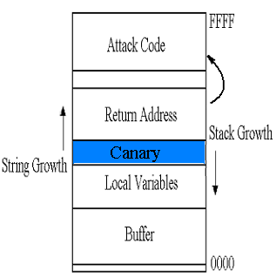
StackGuard
Compiler technique that provides protection by checking the return address in AR
When detects an attack → causes app to exit, rather than yielding control to attacker
  Terminator canary
  Random canary

Slide 91
Heap overflows
Harder to exploit, yet still common
Need to know which variables are security critical
Cause a buffer overflow to overwrite the target variables (generally buffer needs to have lower address)

Slide 92
Example
void main(int argc, char **argv) {
char *super_user = (char *)malloc(sizeof(char)*9);
char *str = (char *)malloc(sizeof(char)*4);
char *tmp;
super_user = super_user - 40;
strcpy(super_user, "viega");
if (argc > 1)
strcpy(str, argv[1]);
else
strcpy(str,"xyz");
tmp = str;
while(tmp <= super_user + 12) {
printf("%p: %c (0x%x)\n", tmp, isprint(*tmp) ? *tmp : '?', (unsigned int)(*tmp));
tmp+=1; } }

Slide 93
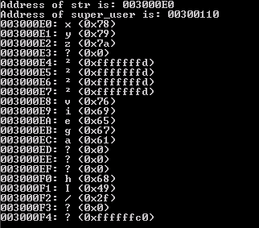
Output

Slide 94
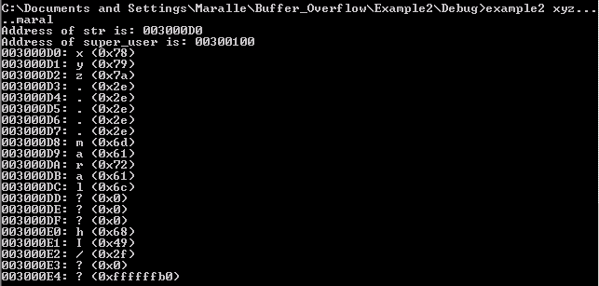
Output after overflow

Slide 95
Auditing for software security
Pre-release software development practices unlikely to change
  Safe languages
  Adequate software design
  Thorough testing
Post-release auditing typically used if warranted
Notes:
Due to economic motivations and software development purposes the pre-release process is unlikely to change.
If there is reason to believe that software has security issues, a security audit may be performed.
If we can reduce the cost and efficiency of audits, developers may be more inclined to use them for preventative measures.

Slide 96
Security auditing problems
Large scale auditing infeasible due code size
Good source code will have 1-3 bugs for every 100 lines of code
Security auditors need to find the software security vulnerabilities in the bugs
Security audits would benefit from a tool that identify areas that are likely vulnerable
Notes:
Due to the code size of large scale systems, auditing is infeasible. Therefore auditors must use their expertise to find areas which could pose a problem. If the system is poorly documented, has been maintained poorly, or gone through a period of rapid feature development auditing becomes a problem of reverse engineering.
Bezier states that for every hundred lines of code in good code there will be 1 to 3 bugs. If the bugs do not violate an explicit or implicit security policy it is not a security vulnerability and therefore of no concern to a security auditor.
Locating security vulnerabilities is a task that requires a lot of manual code browsing and flow tracing.
Security audits would benefit financially, temporally, and rigorously from a tool which locates those areas of code which have been shown to be statistically more vulnerable.

Slide 97
Improving the security audit
Cut down the amount of code needed to be reviewed
Ensure high degree of accuracy
Bottom line: Complexity reduction
Notes:
Managers, why are we here? To address the problem of security vulnerabilities in code.
This problem is going to be addressed with the tools based on sound research.
Reduce the complexity (and thus the time and expense) of security auditing
Manager/Director this research and tools are aimed at improving software security by reducing the complexity of a software audit

Slide 98
The FLF hypothesis
A small percentage of functions near a source of input are more likely to contain software security vulnerabilities
These functions are known as Front Line Functions
Input
FLF
FLF
FLF
Notes:
Lets review the FLF hypothesis again.
Those functions involved with user input are suspect.
These functions constitute a small percentage of the entire system.
At some point following the data provides little benefit from a security standpoint.
We need to validate our hypothesis

Slide 99
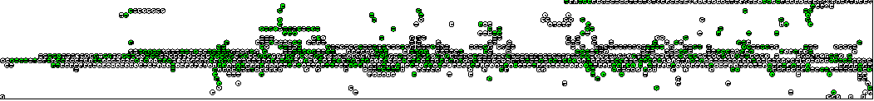
Front line functions
60% Code Reduction
No auditor time required
High degree of accuracy
Notes:
Graph of functions in openBSD 3.1
Green function represent function with a high likelihood of vulnerability (Front Line Functions)
A tool would simply list the suspect functions

Slide 100
Discovering the FLF measurement
Collect software systems with known vulnerabilities
Perform detailed static analyses of software systems
Calculate areas of likely vulnerability from information gathered during static analyses
Build tools around these calculations

Slide 101
How are these tools used?
Run static analysis tools on source code
A database of code facts is created
The database is used to find the likely vulnerable functions
The likely vulnerable functions are outputted and ranked by proximity to input source
Notes:
Lets do a case study to illustrate how these tools are used.

Slide 102
Case Study: OpenSSH
GOAL: FLF Finder identifies large percentage of modified functions
Code that was not change between revisions
OpenSSH 3.1
OpenSSH 3.2.3
Code changed to implement privilege separation
Functions where privilege separation will be implemented
82% of changed functions identified by FLF Finder
Notes:
PRIVELEGE SEPARATION: Between revision 3.1 and 3.2.3, OpenSSH went through changes that struggle to separate code that needed “root” access from code that did not need “root” access
AFTER REV.: Code that implemented privilege separation
BEFORE REV.: These are functions that were changed during the revision
GOAL: The FLF Finder should find a large percentage of those functions that were changed
This means that our findings agree with the security auditors of OpenSSH on what is a likely vulnerable function
A security auditor could use our tools and methods to find those areas of code that are statistically likely to be vulnerable.

Slide 103
Experimental Systems
30 open source systems
31 software security vulnerabilities
Each system has a single patch file which addresses one security vulnerability
Most recovered from Redhat’s source RPM distribution due to their incremental nature
Notes:
SINGLE PATCH FILE: If a certain piece of software had a security vulnerability introduced by an off by one error, then we would try to find the smallest patch which addressed this off by one error
SINGLE PURPOSE PATCHES HARD TO FIND: Because most developers have a set of other bug fixes ready to be released when a security vulnerability is found, finding singular patch files which addressed security vulnerabilities was difficult
SRPMS: Redhat has a certain system of incremental patches which were very useful

Slide 104
GAST-MP & SGA
GNU Abstract Syntax Tree Manipulation Program ( GAST-MP )
  Source Code Analysis tool
  Operates on G++’s Abstract Syntax Tree (AST)
    AST can be outputted with the –fdump-tree-flag
  Creates a repository of code facts
System Graph Analyzer ( SGA )
  Operates on the code fact repository
  Identifies Inputs and Targets
  Performs invocation analysis
  Calculates FLF Density
  Analysis of Categorical Graphs
Notes:
GAST-MP: Builds a entity/relationship repository which can be queried
SGA: System Graph Analyzer
OPERATES ON REP: Queries the repository, to build internal graphs.
FLOW ANALYSIS: These graphs can then be analyzed through flow analysis
Because of the detail within the AST, our tools can perform analysis that typically is hard to do.
Pointer aliasing
Dataflow through function boundaries

Slide 105
Finding inputs
An Input is a function which contains reads in external user input
  For example, read
A list of external function calls were compiled to properly identify Inputs
This list could be modified to contain application specific library calls
Notes:
1. INPUT FUNCTIONS: These functions are functions like read, scanf, recv, and getopt coming from unistd.h, stdio.h, getopt.h, stdlib.h, socket.h

Slide 106
Finding targets
A Target is any function that contains a known vulnerability
Targets are found by matching code facts on subtractive lines in a patch file with code facts in the repository generated by GAST-MP
--- channels.c 27 Feb 2002 21:23:13 -0000 1.170
+++ channels.c 4 Mar 2002 19:37:58 -0000 1.171
@@ -146,7 +146,7 @@
{
Channel *c;
- if (id < 0 || id > channels_alloc) {
+ if (id < 0 || id >= channels_alloc) {
log("channel_lookup: %d: bad id", id);
return NULL;
}
Notes:
SUBTRACTIVE LINES: In this example, all the entities on the subtractive line would be noted as vulnerable. Therefore, the function which contains this subtractive line is a target.

Slide 107
FLF density
Create entire call graph G
Transform G in DAG
Label Input and Target Nodes
Calculate invocation paths between Input and Target combinations and measure length
Calculate FLF Density by normalizing path length by function cardinality
For each system choose the largest FLF Density
Notes:
The FLF Density represents those functions that handled data which was used in a security vulnerability

Slide 108
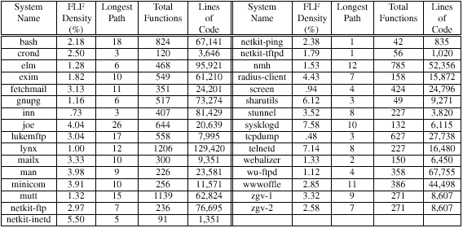
Experimental results
Notes:
The longest path is the longest achievable invocation path between an input and a target.
NORMALIZING FACTOR: We choose function cardinality as a normal because, function cardinality seems to be an accurate representation of function complexity. When path lengths become larger it is an indication of functional complexity and therefore scaling by function cardinality gives a good metric.
WHY NOT PATH LEGNTH: Other suggestions for a normal were longest path and average path. The longest path in a system is implicitly an outlier and therefore not a good normalizing factor. The average path length is a time consuming normalizing factor to compute

Slide 109
Experimental results
Sample mean FLF Density 2.87%
  Therefore, a very small number of functions are actually likely to be vulnerable
Standard deviation of 1.87%
  The FLF density was consistent across our experimental systems
With 95% confidence the true mean is between 2.23% and 3.51%
  There is a high probability that our experimental density is close to the TRUE FLF Density
Notes:
CONFIDENCE: The 95% Confidence is important because the interval is very small

Slide 110

Verification
The FLF Density can be used as a conservative way to highlight those vulnerability functions which do not have known vulnerabilities
Notes:
FLF DENSITY CHECK: These three systems all had security vulnerabilities but were reserved to test the FLF Density
Dhcpd was missed due to function pointers

Slide 111
FLF finder
FLF Density can say what areas of code are statistically likely to be vulnerable
Automate tool to find these areas
Targets are not provided – what do we do?
  Assume all functions are targets
  This extremely conservative assumption is still able to reduce 60% of code!

Slide 112
Research Challenges
Formal Security Architectures
  “The software maintenance community is challenged to investigate the creation of a suite of tools to model and simulate the behavior of security architectures as well as support the verification of properties that are relevant to security”
Security Attack Diagnosis and Mitigation
  “The software maintenance community is challenged to investigate techniques that will enable software to self-diagnose security attacks and self-mitigate the effects of these attacks at run-time”

Slide 113

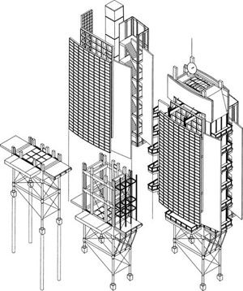
Formal
Security Architectures
The security architectures of industrial-strength software systems are specified using natural language and informal diagrams
These security architectures are validated using manual inspection processes
A barrier to the automation of the analysis of security architectures is the absence of formalism in the notations used in practice to describe security architectures.

Slide 114
Formal
Security Architectures
Future notations and tools to support security architecture may involve:
  Formal modeling notations to specify security architecture
  Tools to simulate the execution behavior of software security models
    Candidate technologies: Generic Modeling Environment (GME) and Ptolemy.
  Model checking tools to verify properties of security architecture
    A candidate technology: Bogor.

Slide 115
Security Attack
Diagnosis & Mitigation
Servers and applications developed using secure coding may still not respond adequately to security attacks at run time
The capacity of a server to diagnose security attacks automatically before it is exploited is important
  especially if the server is used in a safety-critical domain
Self-mitigation strategies are also needed to enable software to continue functioning
  especially if applications and servers are deployed in contexts where patching and re-starting the software is not a practical option

Slide 116
Toward Security Attack
Diagnosis & Mitigation
Develop software sensors that monitor various aspects of the execution behavior of software
Create formal self-diagnostic models based on deviations from a software’s expected behavior
Automatically disable software features and enable security mechanisms at run time in response to diagnosed security attacks
Evolve the diagnostic and mitigation capabilities of software over time by learning from their past experiences

Slide 117
You now know …
… security architectures
... threat modeling
… malware overview
… buffer overflow attacks
… preventing buffer overflow attacks
… front line functions and their role in security auditing
… security attack diagnosis and mitigation

Slide 118
Discussion …
How would you test for buffer overflow vulnerability?
  Web application
  Command line application
  GUI application
  Server

Slide 119
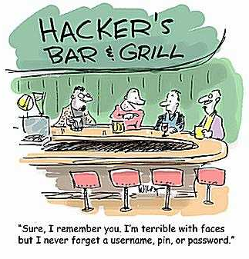
Thank You …

